Slide 1
Online Payment Fraud Detection System
Presented by: Team -17
22H51A7336 – K.Sriram
22H51A7337 –K.Harshavardhan
22H51A7342 – M. Sharathchandra
22H51A7346 – M. Aashrith

Slide 2
AGENDA
1. Introduction
2. Abstract
3. System Flowchart / Block Diagram
4. Requirements
5. Code and Output
6. Conclusion

Slide 3
INTRODUCTION
Online payment fraud detection is a critical aspect of ensuring the security and reliability of digital financial transactions. With the increasing volume of online payments, detecting fraudulent activities in real-time has become more important than ever. This project focuses on building a system that predicts whether a transaction is fraudulent or not, based on various transaction details, such as the transaction type, amount, and account balances before and after the transaction.
The system is built using Python and implements a Decision Tree Classifier, which is a popular machine learning model. The front end of the system is designed using Streamlit, making it easy for users to interact with the model by entering transaction details and receiving predictions.

Slide 4
ABSTRACT
The Online Payment Fraud Detection System is designed to predict fraudulent online transactions in real-time. By utilizing machine learning and a user-friendly interface, this system can efficiently classify transactions as fraudulent or non-fraudulent.
The system leverages a Decision Tree Classifier, trained on a dataset that contains transaction information, including transaction type, amount, old balance, and new balance. The trained model is embedded in a Streamlit web application, which allows users to input transaction details and receive instant fraud predictions. This system aims to reduce the occurrence of financial fraud by providing a tool that can flag potentially fraudulent transactions before they are processed.

Slide 5
Block Diagram
Start Application
User Inputs Data (Type, Amount, Balance)
Pass Data to Model (Decision Tree Classifier)
Model Predicts Fraud
Display Result ("Fraud" or "No Fraud")
End

Slide 6
REQUIREMENTS
To run the Online Payment Fraud Detection System locally, you need to set up your environment with the following prerequisites:
Prerequisites:
Python 3.x
pip (Python package installer)
Required Libraries:
The following libraries are used in the project:
Streamlit: For creating the user interface.
Scikit-learn: For implementing the machine learning model.
Pandas: For data manipulation and processing.
Joblib: For loading the pre-trained machine learning model.

Slide 7
Code
import streamlit as st
import pandas as pd
from sklearn.tree import DecisionTreeClassifier
from joblib import load
# Load the pre-trained model
model = load('fraud_detection_model.pkl')
# Define the Streamlit app
def fraud_detection():
st.title("Online Payment Fraud Detection System")
# Transaction Type Selection
transaction_type = st.selectbox("Select Transaction Type", ["CASH_OUT", "PAYMENT", "TRANSFER", "DEPOSIT"])

Slide 8
# User Inputs: Amount, Old Balance, New Balance
amount = st.number_input("Enter the Transaction Amount", min_value=0.0, step=0.01)
old_balance = st.number_input("Enter the Original Balance", min_value=0.0, step=0.01)
new_balance = st.number_input("Enter the New Balance", min_value=0.0, step=0.01)
# Prediction Button
if st.button("Predict"):
# Prepare the input data for prediction
input_data = pd.DataFrame({
'TransactionType': [transaction_type],
'Amount': [amount],
'OldBalance': [old_balance],
'NewBalance': [new_balance]
})
# Predict using the pre-trained model
prediction = model.predict(input_data)
# Display the result
if prediction == 1:
st.error("Fraudulent Transaction Detected!")
else:
st.success("Transaction is Legitimate.")
# Run the Streamlit app
if __name__ == '__main__':
fraud_detection()

Slide 9
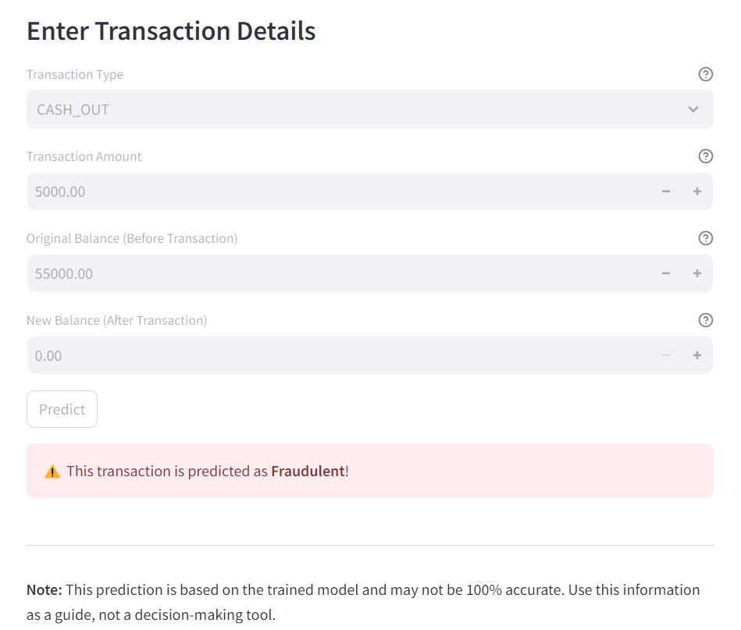
Output

Slide 10
CONCLUSION
This Online Payment Fraud Detection System effectively demonstrates how machine learning can be used to detect fraudulent transactions in real-time. By using a Decision Tree Classifier, the system classifies transactions based on their features (such as transaction type, amount, and balance). The Streamlit interface makes it easy for users to input transaction details and get instant feedback.
The system's effectiveness depends on the quality and size of the dataset used to train the model. While the current model can predict fraud with reasonable accuracy, further improvements can be made by incorporating more sophisticated models, using additional features, and continuously updating the model with new transaction data.

